Slide 1
Basic Scrum
Part Deux
18F Training

Slide 2
Agenda
Part I:
Part II:
Agile Dev Model and Lifecycle
Scrum Process Framework
Product Backlog and Product Owner
User Stories
Delivery Team
Sprint Planning
During the Sprint
Sprint Review
Sprint Retrospective
Benefits of Scrum

Slide 3
The purpose of Sprint planning is to agree on which items will be the team focus in the sprint.

Slide 4

Sprint Planning
Inputs
Product Backlog
Velocity History
Team and World Circumstances
Outputs
Task Breakdown
Capacity Plan
Sprint Backlog
Sprint Goal
Commitment or Forecast or Focus

Slide 5
2-Step Sprint Planning
Big Picture
Rolling Release Planning/Roadmap Update
Review top of Product Backlog
Part I
Nitty-Gritty
Detailed understanding of the work
Readiness, discussion, task breakdown
Focus/Commitment/Forecast
Part II
*Max 1 hours of planning per sprint week (~7%)

Slide 6
Introductory Statement
Introductory Statement
A quick ramble on commitment vs. forecast vs. prediction and also estimation

Slide 7

During the Sprint

Slide 8

Scrum Master
SCRUM
MASTER
Change Agent
Servant Leader
*Process Champion
*Obstacle Remover

Slide 9

Defining a Scrum Standup
The Daily Scrum (aka Standup)
It’s about Self-Organization*
Basics:
Daily, 15-minute sync-up
Same time, same place
Stand-up, no problem solving
Answer the 3 questions:
What did you do yesterday?
What will you do today?
Are you blocked?
Impediments = SM’s Task List
*Not status!
Daily
Meeting

Slide 10
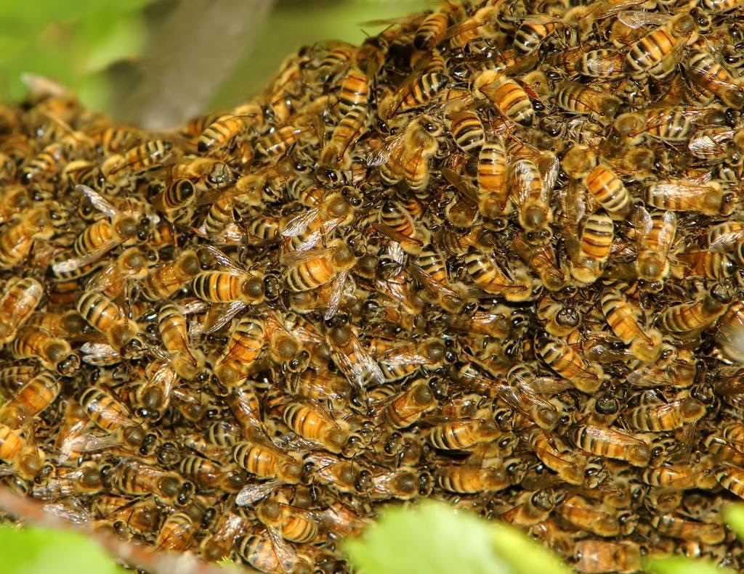
SWARM

Slide 11
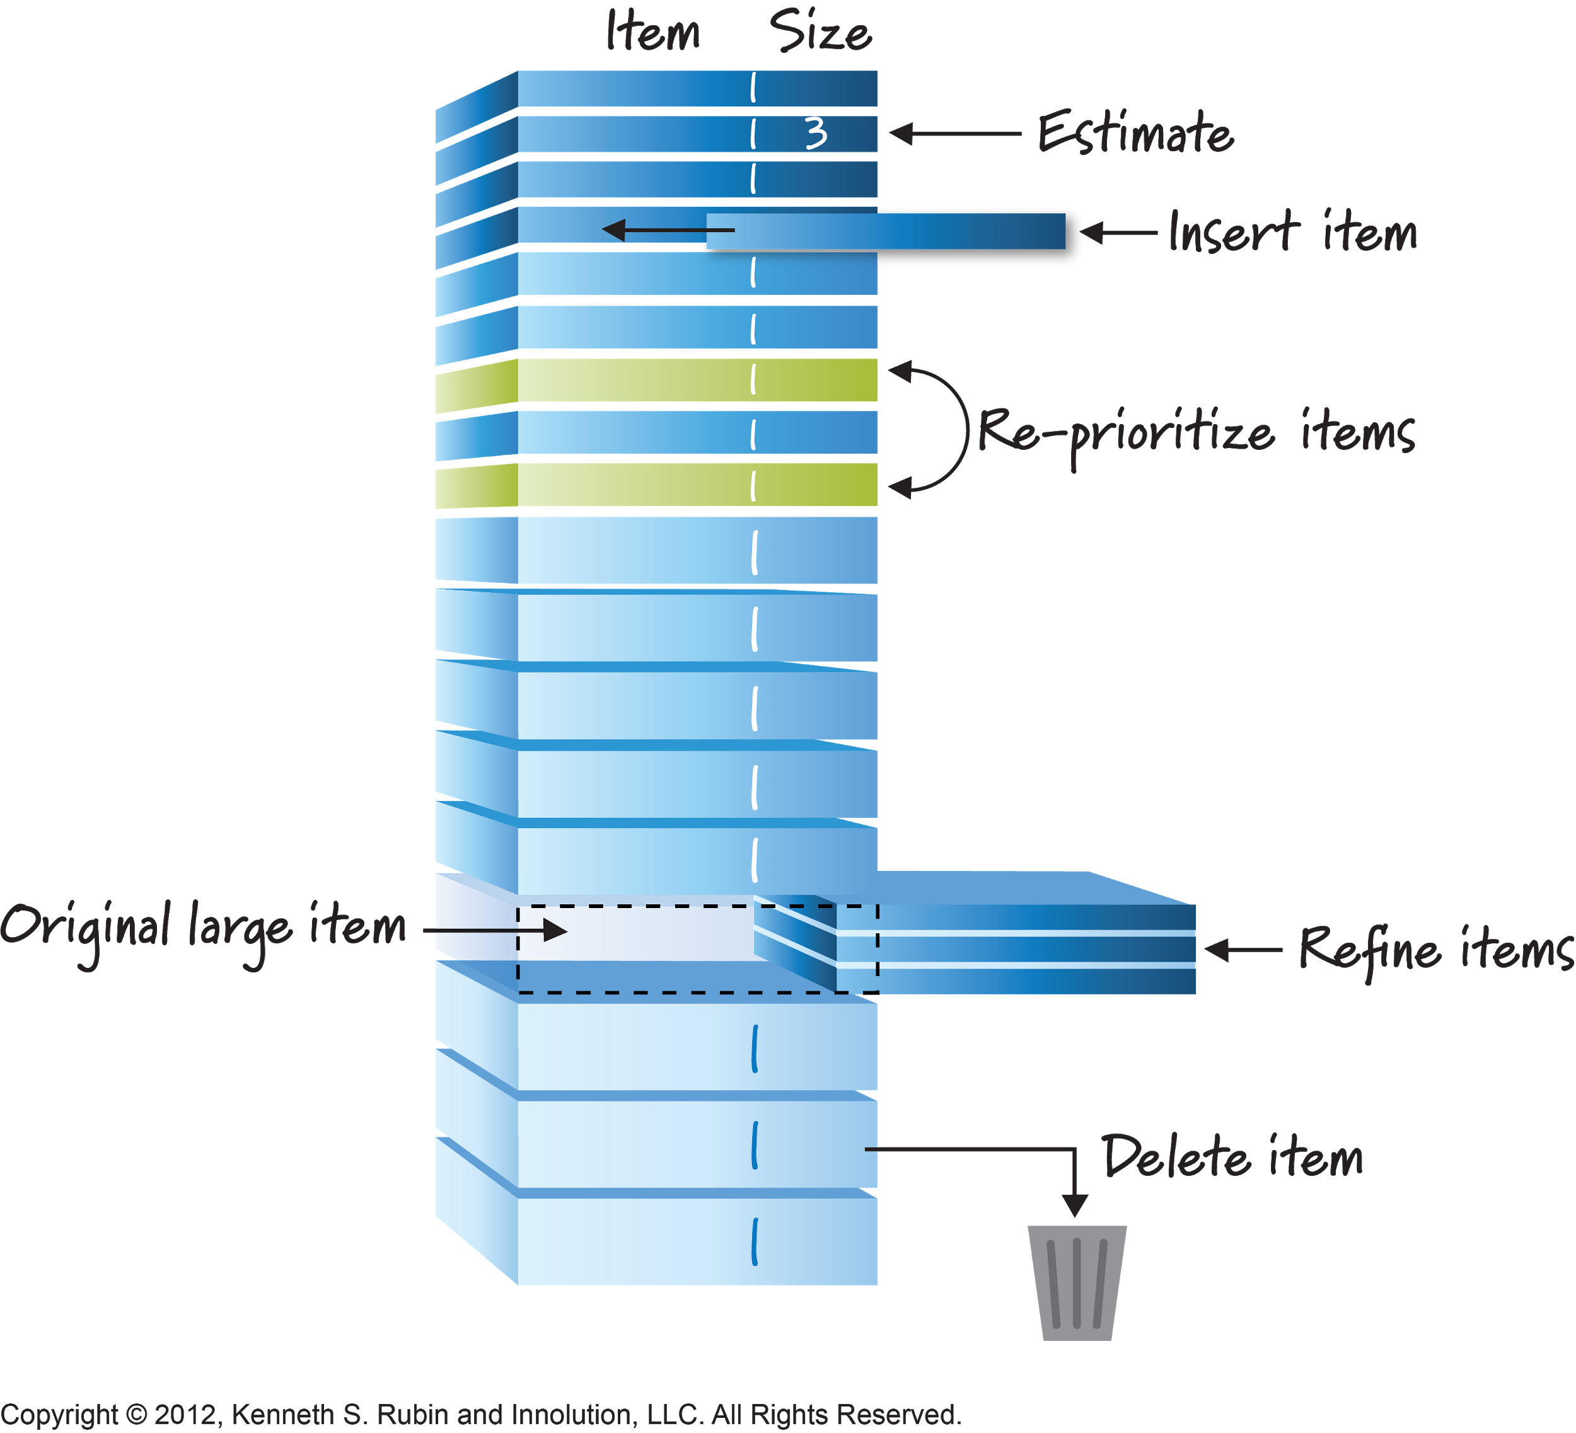
Backlog Grooming

Slide 12

PRODUCT OWNER ACCEPTANCE
Notes:
We only demo work that is accepted
RW

Slide 13
Basic Definition of Done
Code Complete
Fully Tested
No Known Defects
Checked In
Tested in Official Test Environment

Slide 14
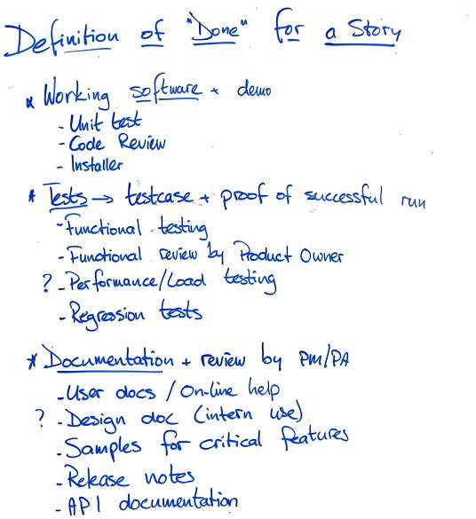
Sample Definition of Done

Slide 15



End of Sprint
Sprint Review
Potentially Shippable Software
Sprint
Retrospective

Slide 16
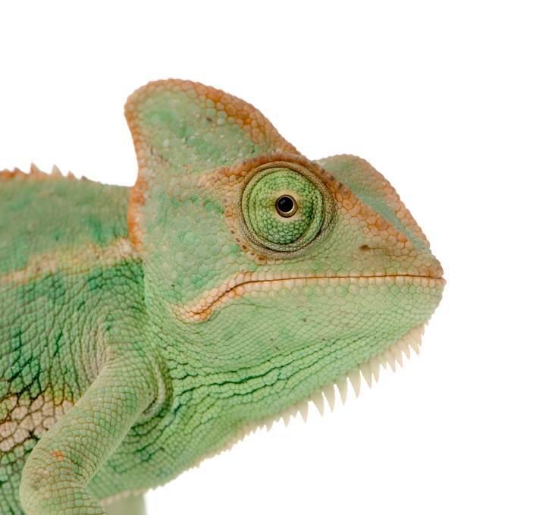
INSPECT AND ADAPT

Slide 17
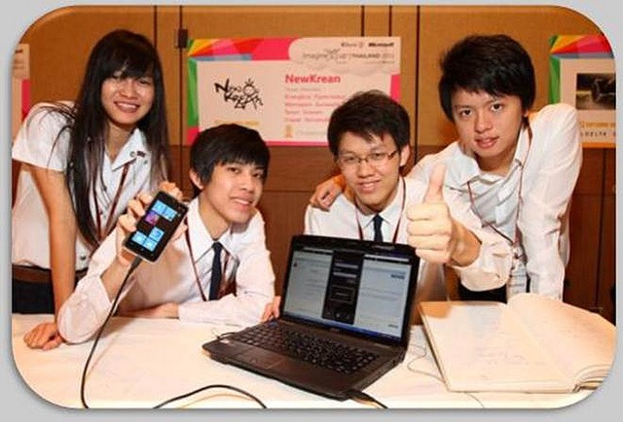
Sprint Review (aka “The Demo”)
Everyone’s invited
Working software
Minimal prep time
Informal
Interactive
Max 1 hour per sprint

Slide 18

Visual Aid for a transition to a new section about retropectives
RETROSPECTIVE

Slide 19

Visual Aid for defining safety
Safety

Slide 20
Inspirational Quote
“Everyone on this team has continued to do their best work and to contribute to the team at the highest possible level. The purpose of this meeting is not to place blame, but to learn and improve.”

Slide 21
Workups for Sprint 96 with review and metrics
Sprint 96
How are our changes working?
Write and implement a story for better alerting on hourly build failures
Ask about how many stories have the design label in the next sprint in design grooming
Post acceptance threads for stories in Slack
Ask question about story size during grooming
Pull up the epic board during design grooming
Metrics
Velocity (stories completed and accepted)
This sprint: 16 Rolling avg. (past 5 sprints): 15.8
Stories started but not finished
This sprint: 6 Rolling average (past 5 sprints): 6
Average PR lifespan
This sprint: 65 Rolling average (past 5 sprints): 58.6
Bugs reported against deployed code:
This sprint: 3 Rolling average (past 5 sprints): 13
What did we do well?
Other team coming to PR reviews seems to have helped get their PRs merged - JH
Looking ahead at the next sprint in design grooming - MG +
Refactored a major Gordian knot with the failure presenters - SU

Slide 22
Workup for Sprint 96 with review and metrics continued
What did we do well?
Other team coming to PR reviews seems to have helped get their PRs merged - JH
Looking ahead at the next sprint in design grooming - MG +
Refactored a major Gordian knot with the failure presenters - SU
What could we do better next time?
Are we converting pages to the design system? - JH
IAL2 improvements - how to account for it in coming sprints - PA
Not enough people - JH
Velocity slowly falling off - JH
What other Gordian knots exist? - PA
2 factor authenticatable
OAuth handoff
All of our SAML code
The sign up completion page
The old verification flow handing off to the doc auth flow
What should we implement after this retro?
Write a tool for tracking how many templates we have converted to the new design system++
Have a meeting time to build research findings into an epic for improving identity verification+++++
Reduce usability testing to once every 2 sprints to free up design time++++
Dockerize the app to run in windows+++++++

Slide 23
Visual process for scrum planning
How much will we finish by when?
(Planning in Scrum)
Most important stories here
At our slowest velocity we’ll get here
At our average velocity we’ll get here
Least important stories here
At our fastest velocity we could get to here
23
Notes:
This also opens up chance to say “Is this really average? What’s *really* important?” Remember this backlog has been changing on the regular. In waterfall you have to have this right out of the box, and then your end date will have to move to get everything in.

Slide 24
Applicability of Scrum
Works Well
Not so well
SW Development
Great for complex projects
Stable Teams
Empowerment
Plannable Work
Short projects
No teams
Constant product change
Ops and maintenance

Slide 25
Listing the Benefits of Scrum
(Potential) Benefits of Scrum
Higher productivity
Higher quality
Increased Flexibility and Customer Focus
Reduced time to market
Lower risk
More fun, more satisfying for the team

Slide 26
Enough about scrum already!

Slide 27

Information About these slides
Slides in this presentation contain items from the Visual AGILExiocn®, which is a trademark of Innolution, LLC and Kenneth S. Rubin.
The Visual AGILExicon is used and described in the book: Essential Scrum: A Practical Guide to the Most Popular Agile Process.
You can learn more about the Visual AGILExiocn and permitted uses at: http://innolution.com/resources/val-home-page

